Slide 1
Living the dream
Real world DevOps with Azure and VSTS

Slide 2





Rik Hepworth
Consulting Services Director
MVP (Azure)
@rikhepworth
github.com/rikhepworth
blogs.blackmarble.co.uk

Slide 3

Riccardo Viglianisi
Consultant
@captainshmaser
github.com/captainshmaser
blogs.blackmarble.co.uk

Slide 4

What is DevOps
“Development and Operations collaboration”
“Automation”
“Faster and smaller releases”
“A job title”
Notes:
So, what is DevOps exactly?
DevOps is a term for a group of concepts that, while not all new, have catalyzed into a movement and are rapidly spreading throughout the technical community.
Like any new and popular term, people have different and sometimes contradictory perceptions of what it is.
One thing is sure: it’s not a product that you buy and install to fix everything that is wrong or broken with software development.
However, tooling is an integral part of any DevOps discussion because tools help you execute on your DevOps strategy.
Today we’ll talk about how the application lifecycle is changing as it extends into IT operations and will take a closer look at our next wave of ALM and DevOps investments.

Slide 5
DevOps is the union of people, process, and products to enable continuous delivery of value to our end users. Donovan Brown

Slide 6




Walking through the process
Develop
Build
Deploy to QA
Deploy to Lab

Slide 7
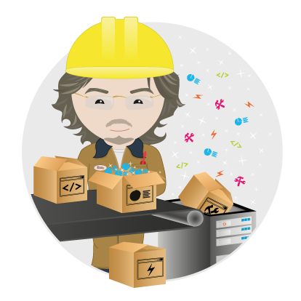
Automating the Dev/Deploy Process
A walk through Continuous Delivery

Slide 8
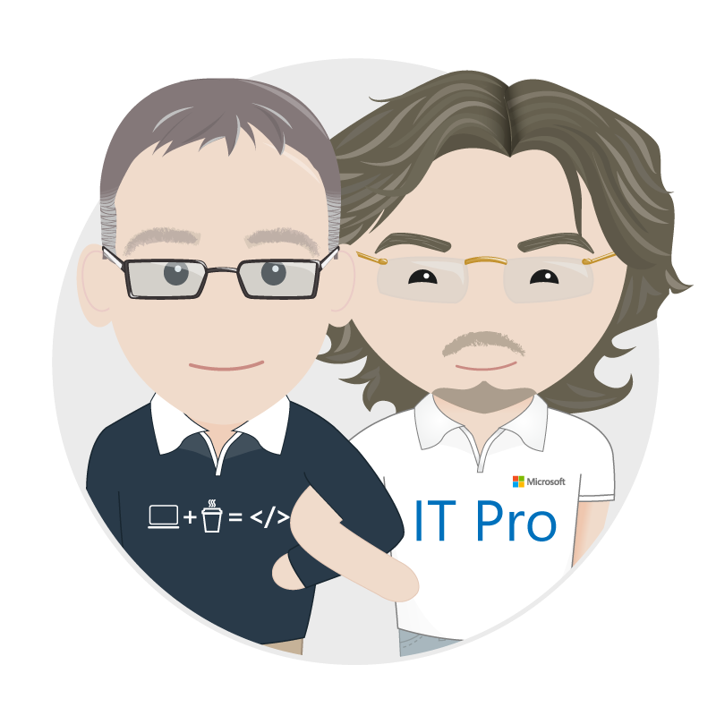
And in Summary

Slide 9
Useful Links
VSTS Marketplace https://marketplace.visualstudio.com/vsts http://bit.ly/VSTSBM (Black Marble extensions in marketplace)
Our Githubs: https://github.com/rikhepworth https://github.com/rfennell
Our Blogs: https://blogs.blackmarble.co.uk
@rikhepworth
github.com/rikhepworth
github.com/rfennell
blogs.blackmarble.co.uk

Slide 10

How We Can Help
DevOps and Cloud Adoption Workshops Broad-ranging workshop to assess your current situation, understand your strategy and direction and help plan.
Specialist Consultancy Our experts can support your team with DevOps automation
Microsoft Deployment Planning Services (DPS) Use your Software Assurance points for planning services around DevOps and Visual Studio Team Services/Team Foundation Server
Amy Gwyther
Senior Business Development Manager
amy@blackmarble.com

Slide 12

“It was taking up to 12 days to develop a line of code – that didn’t feel appropriate to the speed at which we wanted to deliver features to our customers.
Thanks to the work we’ve undertaken with Black Marble and Microsoft this process is now down to a matter of hours.”
- Chief Product Architect

Slide 13
Three Objectives
Automated environment creation
Change attitude to environments
Rapid deployment of new environments

Slide 14
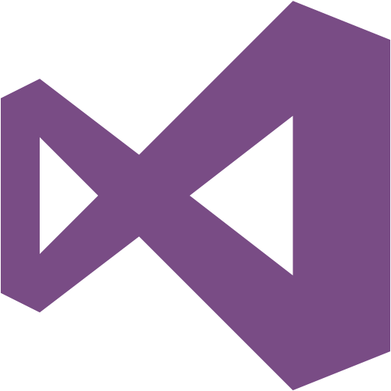
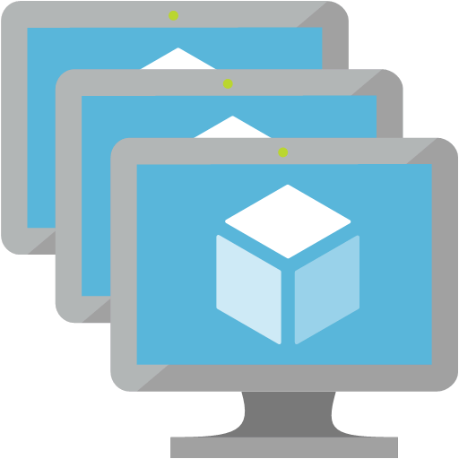


The Technologies
Visual Studio Team Services
Azure IaaS
Azure Resource
Templates
Azure DevTest Labs
Work tracking
Source repository
Automated build
Automated release
Multi-server environments for dev and test
Windows and Linux
Configuration as code declaration of environments
Managed wrapper for dev team environments

Slide 15
Early project wins
Kick-started cultural change in development
Demonstrated that up to 60% of time spent on activities such as regression testing will no longer be needed
Increased the SLA that can be offered to customers
Demonstrated a way to rapidly develop & release individual customer requests
Architected a way to reduce Code to Customer times from weeks to hours
Reduced projected cost of service in dev time, and hosting costs
Removed server downtime
Provided a safe way to try new ideas at minimal cost
Enabled dev streams to be re-launched

Slide 16
Benefits for end customers
Cost savings through increased service availability
Feature releases in hours, not weeks
Shortened service request cycles
‘Single Pane of Glass’ web-based services where customer & engineer can work hand-in-hand
Closer relationship through more regular interaction
Faster, smaller updates vs bulky major releases
Increased opportunity for innovation as ideas can be rapidly put into play in test environments

Slide 17
“It’s a mindset and organisational change – we had been fairly ‘traditional’ when it came to IT services so we didn’t take lightly the decision to introduce DevOps, but we knew in Black Marble we had absolutely the right partner for the job. The fact they’d been referred to us by their peers said a lot to use about the quality of what they could deliver.”
- Chief Product Architect

